Slide 1
Teachers and students to the class

Slide 2
I. REVISION: Kim’s game
- Look at the pictures and remember.(6 pictures)
- Each person in each group writes only 1 activity as fast as posible.
- In 1 minute if which group writes more correct activities is the winner.

Slide 3
Flying a kite

Slide 4
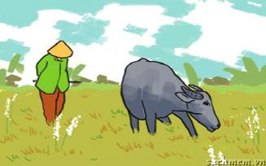
Herding buffaloes

Slide 5
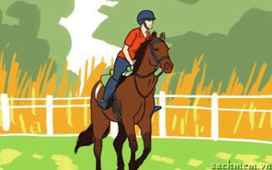
Riding a horse

Slide 6
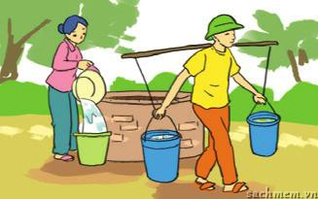
Collecting water

Slide 7
drying the rice

Slide 8
loading the rice

Slide 9
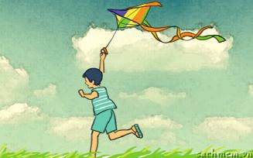
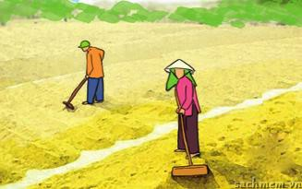
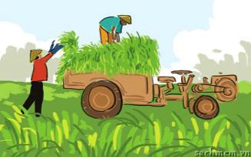
flying a kite
herding buffaloes
riding a horse
4. collecting water
5. drying the rice
6. loading the rice

Slide 10
Friday, September27th, 2019
Period 7: WEEK 7
Read about life in the countryside

Slide 11
II. Practice:
Exercise 1: Complete the sentences with the words in the box.
harvest time, picking, noisy, herd, inconvenient, peaceful
picking
When summer comes, we enjoy...................................................fruits
Our village has no running water, which is very………………………………
A busy time when people collect their crop is called..................................................
You can relax in the countryside. It’s so .........................................................
In the countryside, children learn to …………………the cattle when they are small.
inconvenient
harvest time
peaceful
herd

Slide 12
Exercise 2. Read the passae and do.
My village
We are Khmer Krom, one of the biggest ethnic groups in the south of Viet Nam. We live by farming- Mostly rice- and fishing on the Mekong river. Life is sometimes hard because our work depends heavily on the weather. When it is not harvest time, the men of the village go fishing from early morning and don’t return until late afternoon. By the time the fishing boats return, most of the village women will be waiting for them on the river bank. They wait to buy the fish, which they will later sell at the local market or bring to nearby town for a higher price. We children will be there too. We love running around the beach and waiting for the boats to come in.
Our most important festival of the year is Chol Chnam Thmay, which celebrates the New Year. It Falls in mid- April. Every family tries to prepare well for the festival activities. The community also visits and helps the poor families so that everybody has a happy New Year.

Slide 13
A. Are these sentences true (T ) or fasle (F)
T
F
Khmer Krom live by farming- mostly rice- and fishing on the Mekong river.
2. The life there is very easy.
3. The men of the village go fishing in late morning.
4. The women and children wait on the river bank to buy the fish.
5. The community helps the poor families because they want everybody to have a happy life.
X
X
X
X
X

Slide 14
B. Read again and answer the questions.
1. Where do the Khmer Krom live?
2. Why is life hard for the Khmer?
3. What do the women do with the fish they buy from the fishment?
4. What is Chol Chnam Thmay?

Slide 15
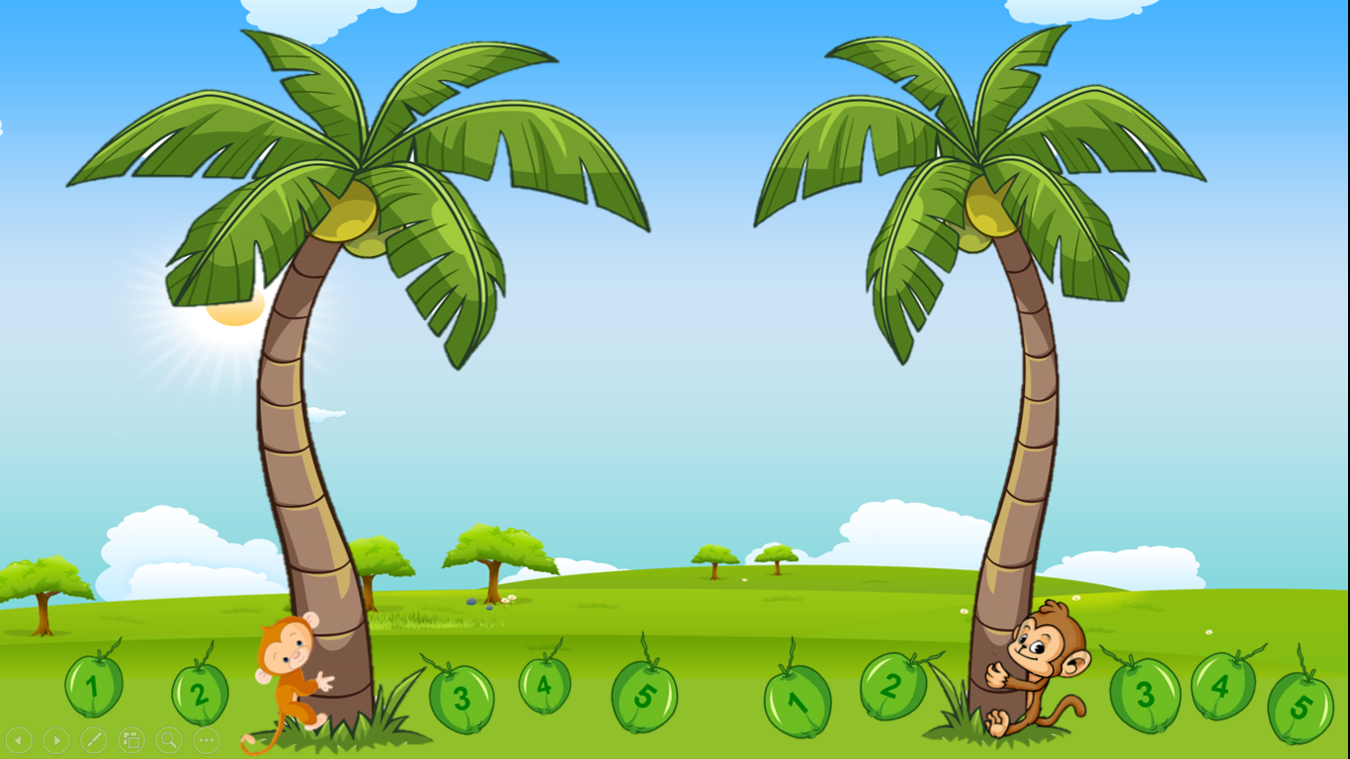
MONKEYS COMPETITION

Slide 16
CHÚC MỪNG
CHÚC MỪNG

Slide 17
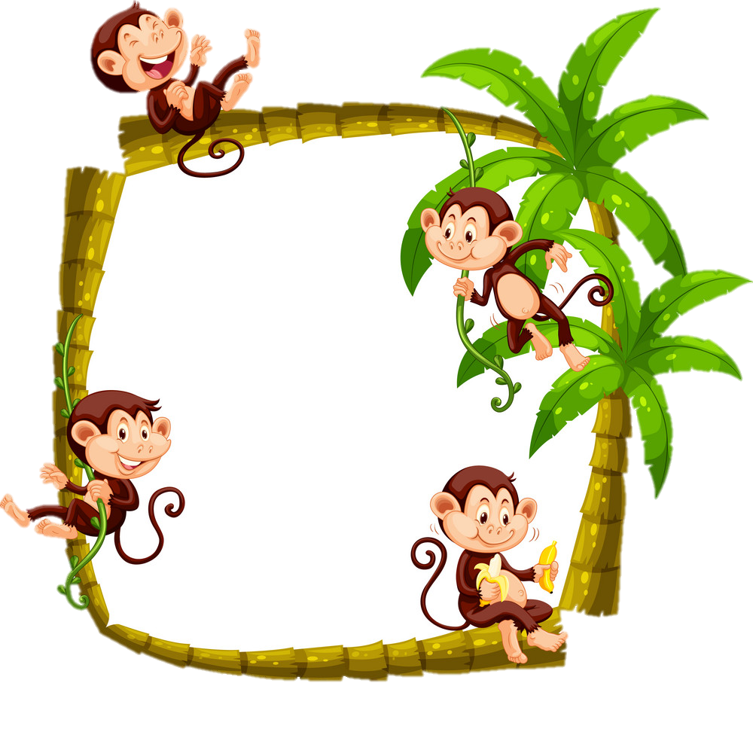
3. What do the women do
with the fish they buy
from the fishment?
They sell them at the local
market or the town nearby
for for a higher price.

Slide 18
1. Where do the khmer Krom live?
In the south of Viet Nam.

Slide 19
4. What is Chol Chnam Thmay?
It’s a celebration of the
new year.

Slide 20
2. Why is life hard for the Khmer?
Because their work depends heavily
On weather.

Slide 21
4. What is Chol Chnam Thmay?
It’s a celebration
of the new year.

Slide 22
You can climb.

Slide 23
You can’t climb.

Slide 24
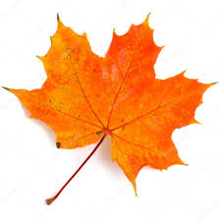
Exercise 3: Use”used to” to make sentences.
Work in groups to make sentences about your parents used to do in the past in your village but now they don’t do.
Eg: They used to go swimming in the river.

Slide 25
III. Homework:
- Do again all the exercises in the notebooks.
- Prepare some sentences about the changes of life in the countryside.

Slide 26
Thanks for your attention

